Slide 1

MADNESS
By: Nicholas Kimmel

Slide 2
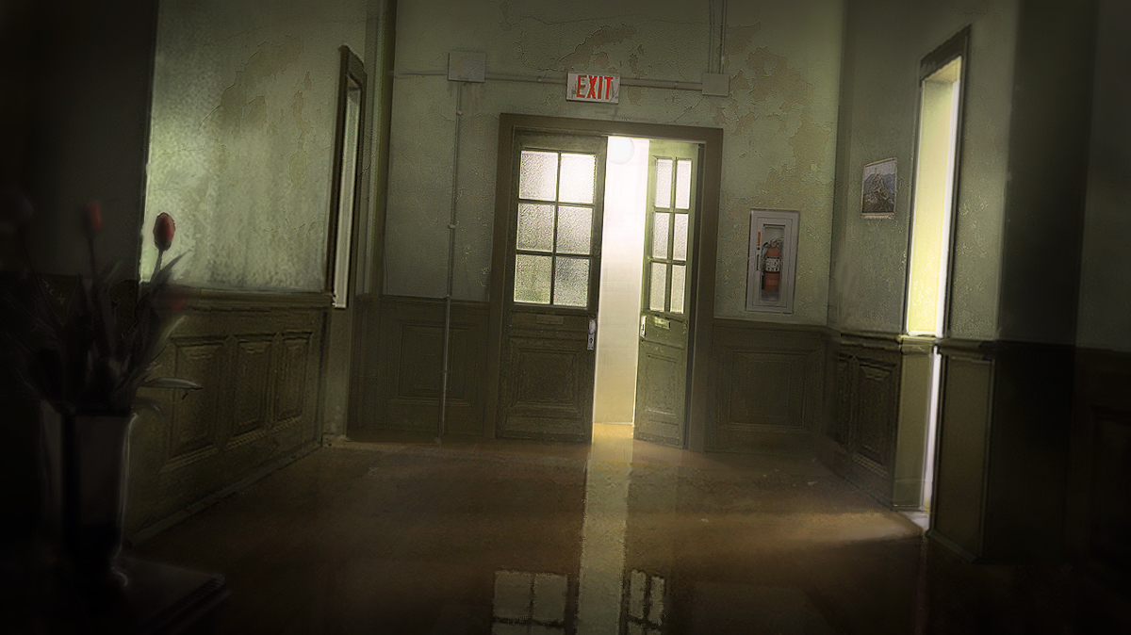
A million voices were all screaming in my head, telling me it was coming, urging me to escape, I didn’t know where I was or how I got there

Slide 3
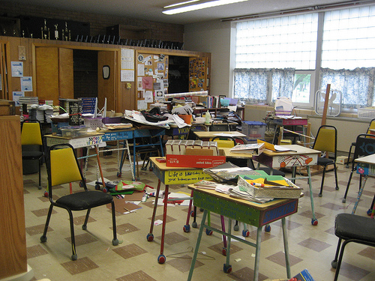
I looked around in a total panic; searching, hoping for a weapon for anything I could use to defend myself
I picked up a textbook, the only thing I could find, and turned, ready to fight for my survival

Slide 4

I woke up in my bed screaming my challenge to whatever was chasing me

Slide 5

I blinked several times and looked around realized I had just woken up from a nightmare, again

Slide 6

Now, looking at me you would think I have it all, that my life is without worries; straight A’s, starting varsity football, seemingly at the center of everything, there is nothing else I could really want

Slide 7
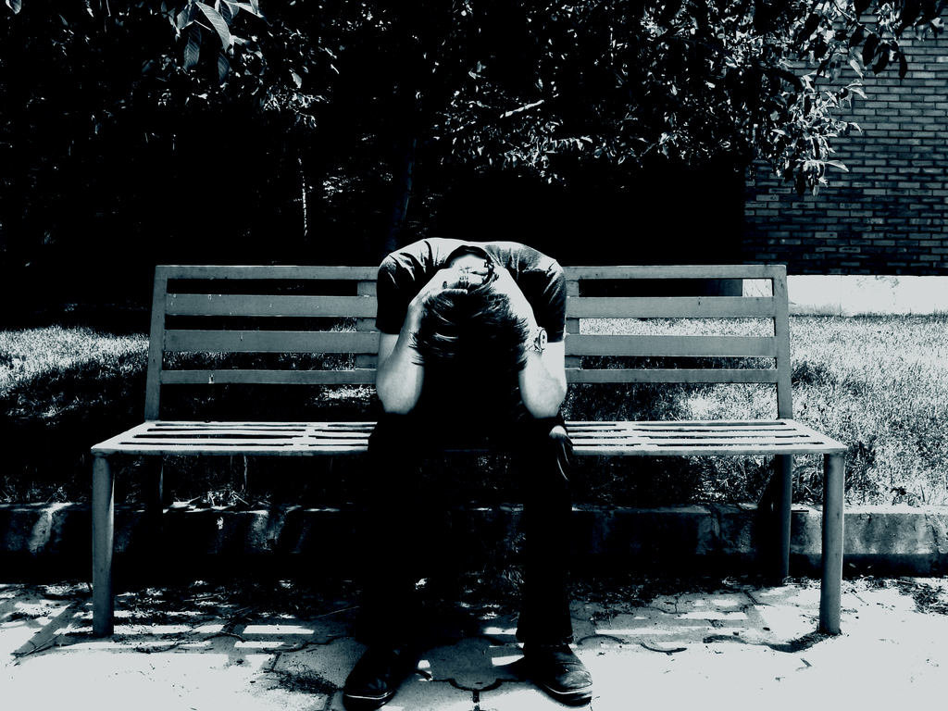
But hidden behind all that success, is a hidden longing. I’ve never shared it with anyone. I wish, hope, dream of having what so many other people take for granted.
SANITY

Slide 8

I struggle with my grasp on reality, never knowing if something is really there or just a phantom

Slide 9
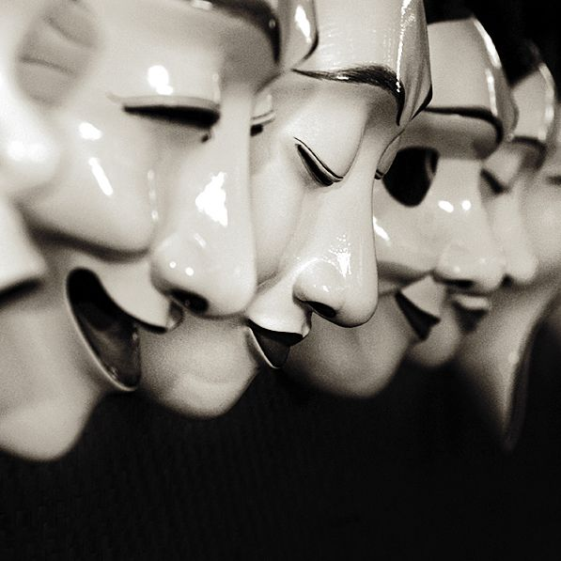
At school I’m fine, for whatever reason my mind seems content to let me live my life, I can hide behind that, no one knows
But at home…
Things are different

Slide 10

At home, my mind plays tricks on me, I can never tell what is real, and what isn’t. Whether something really happened or if it was just a fantasy

Slide 11

If you notice I never talk about my past, there is a good reason for this…
I don’t know what it is

Slide 12

Have I always been this way or did it just start this morning?

Slide 13

Has my mother been dead since I was little or did she call me at school today to say she was going to be late?

Slide 14

Are my parents divorced or is my father right now upstairs in his study?

Slide 15
I DON’T KNOW

Slide 16
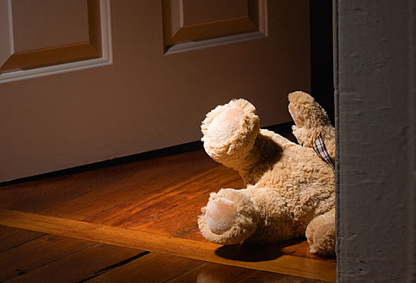
For some people sleep is their escape. They can expect to wake up the next morning refreshed and ready for a great new day
I envy them

Slide 17

My nights are filled with the same uncertainty and terror as my days. Sometimes I don’t even realize I’m asleep until I wake up the next morning.
I don’t even know if I’m asleep right now, as I’m writing this
I try not to think about that

Slide 18

At school, I seem so normal
Sometimes… It even fools me

Slide 19

I hope, believe even, that when I get home, it will be a normal family. That I’ll have a loving mother and father, maybe even siblings

Slide 20

Bit it never happens
I’m losing hope it ever will

Slide 21

Every day I re-enter into that sleepless nightmare of my existence
I don’t know who I am…
Or if it’s even possible for me to become anything good
If I have something to look forward to

Slide 22
I’m beginning to think that it will never happen, nothing will come of me
After all, what future can there be for someone
WHO IS MAD?

